Slide 1
Mini Popper | Colt poppers | Pepper poppers | Plates | Wall feet
4 | 6 | 5 | 0 | 55
Bay | Stage | Target Type | Count | NS | Total | Hard Cover
A2 | Peekaboo | USPSA | 8 | 4 | 12 | 2 Tux 1 Left Diag 2 Right Diag
A1 | Curve Crush | USPSA | 6 | 0 | 6 | 1 Left Diag 1 Right Diag 2 50%
B1 | Arrow Assault | USPSA | 11 | 0 | 11
B2 | Four Corners | USPSA | 9 | 1 | 10
B3 | Position No Shoot | USPSA | 10 | 5 | 15
B4 | CM 99-42 | USPSA | 4 | 0 | 4
IPSC | Tux | 0
IPSC | Left Diag | 0
IPSC | Right Diag | 0
IPSC | 50.00% | 0
USPSA | Tux | 2
USPSA | Left Diag | 2
USPSA | Right Diag | 3
USPSA | 50.00% | 2

Slide 2
Prop | Stage

Slide 3

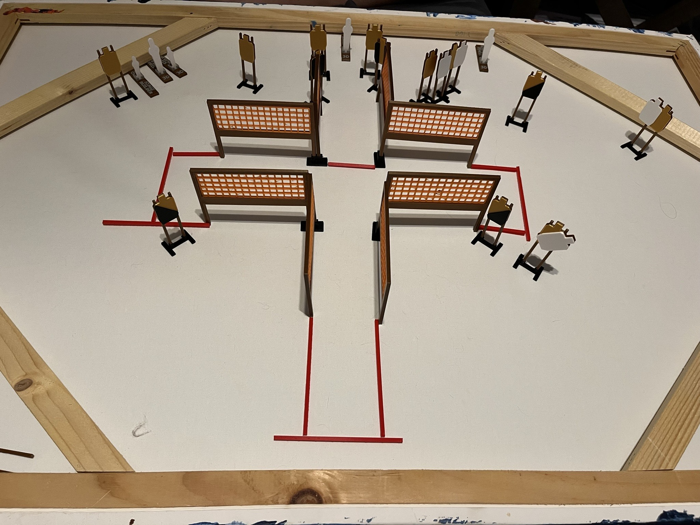
 | Dothan Practical Shooters – USPSA Match Peekaboo Course Designer : Jeremy Stevens Bay: A2
Round Count 31 rounds 13 USPSA 3 colt poppers, 2 mini poppers
Equipment List 12 wall feet 1 left diag, 2 right diag, 2 tuxes 12 targets (8 + 4 NS)

Slide 4
Stage Name
Written Stage Briefing
Scoring: Comstock Rounds: 31
Targets: 13 USPSA, 5 steel
Handgun start position: anywhere completely outside the shooting area, wrists below belt. Handgun is loaded and holstered.
PCC start position: anywhere completely outside the shooting area, stock on belt. Loaded carbine is held with both hands, safety on.
Stage Procedure: on the audible start signal, engage targets as they become available from within the shooting area.

Slide 5
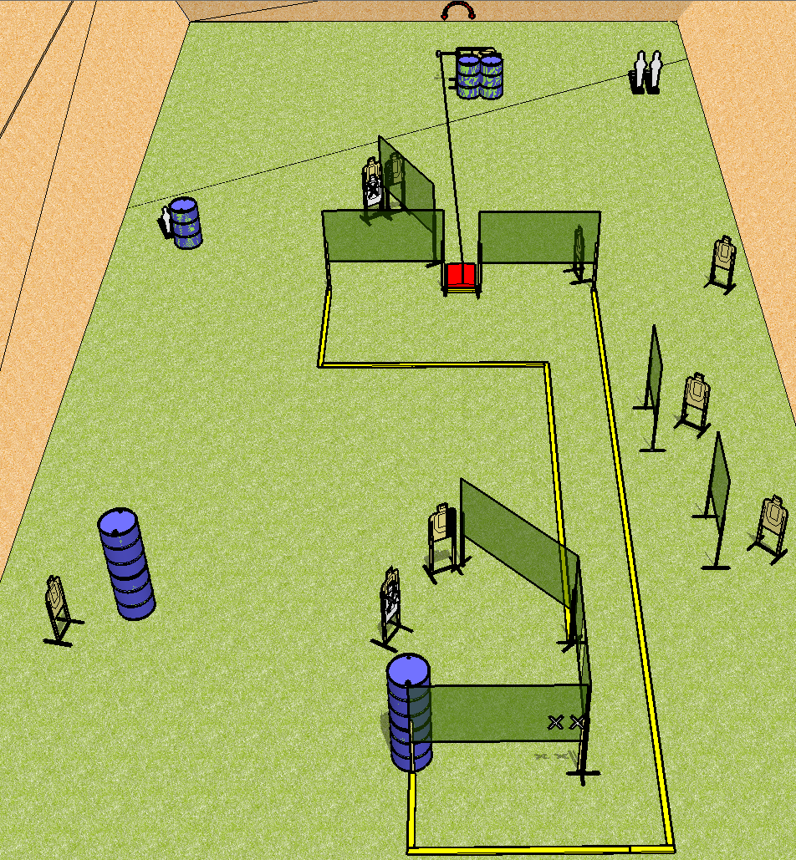
 | Dothan Practical Shooters – USPSA Match Curve Crush Course Designer : Andrew Hobbs Bay: A1
Round Count 23 rounds 10 USPSA 2 colts poppers, 1 mini popper
Equipment List 15 wall feet Stomp pad + swinger 1 right HC, 1 left HC 10 targets (8 + 2NS)

Slide 6
Curve Crush
Written Stage Briefing
Scoring: Comstock Rounds: 23
Targets: 10 USPSA, 3 steel
Handgun start position: hands touching marks. Handgun is unloaded and holstered.
PCC start position: muzzle touching mark, stock on belt. Unloaded carbine is held with both hands.
Stage Procedure: on the audible start signal, engage targets as they become available from within the shooting area. The swinger is activated by the stomp pad and remains visible at rest.

Slide 7
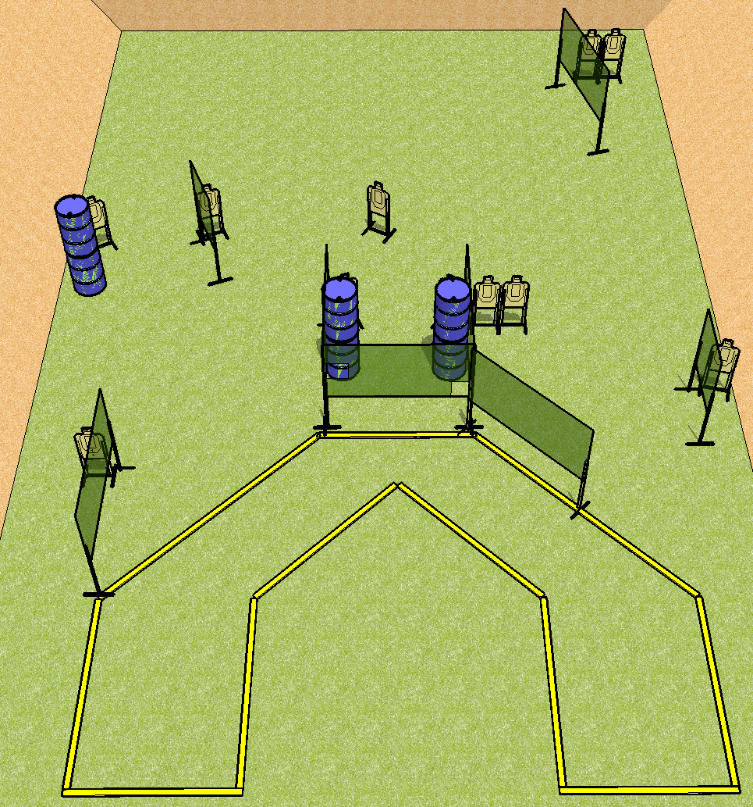
 | Dothan Practical Shooters – USPSA Match Arrow Assault Course Designer : Andrew Hobbs Bay: B1
Round Count 22 rounds 11 USPSA
Equipment List 12 wall feet

Slide 8
Clever Name
Written Stage Briefing
Scoring: Comstock Rounds: 22
Targets: 11 USPSA
Handgun start position: anywhere inside the shooting area, wrists below belt. Handgun is loaded and holstered.
PCC start position: anywhere inside the shooting area, stock on belt. Loaded carbine is held with both hands, safety on.
Stage Procedure: on the audible start signal, engage targets as they become available from within the shooting area.

Slide 9
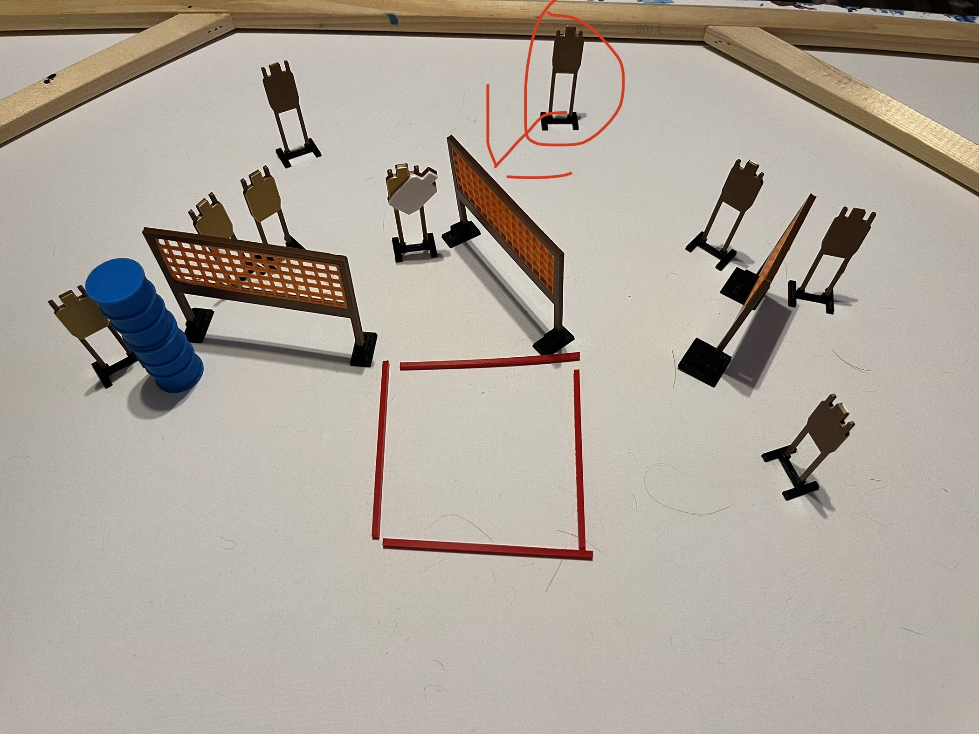
 | Dothan Practical Shooters – USPSA Match Four Corners Course Designer : Jeremy Stevens Bay: B2
Round Count 18 rounds 9 USPSA
Equipment List 6 wall feet 10 targets (9 + 1NS)

Slide 10
Four Corners
Written Stage Briefing
Scoring: Comstock Rounds: 18
Targets: 9
Handgun start position: feet on X’s, wrists below belt. Handgun is loaded and holstered.
PCC start position: feet on X’s, stock on belt. Loaded carbine is held with both hands, safety on.
Stage Procedure: on the audible start signal, engage target as they become available from within the shooting area.

Slide 11
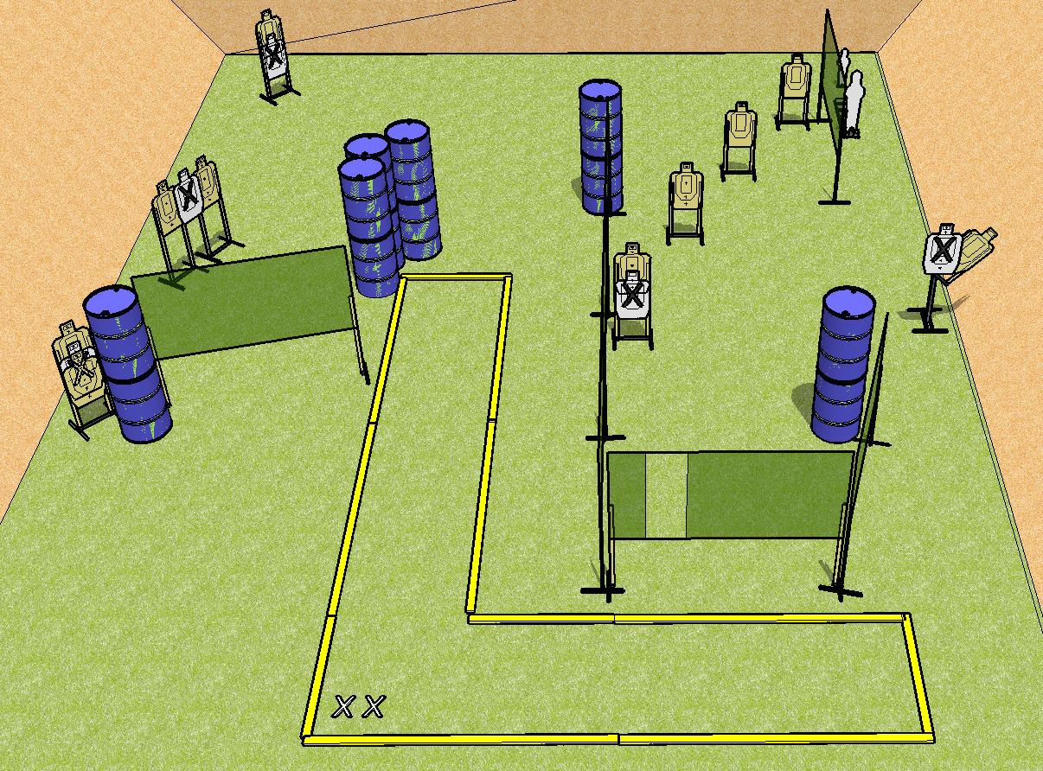
 | Dothan Practical Shooters – USPSA Match Position No Shoot Course Designer : Cory Hobbs Bay: B3
Round Count 22 rounds 10 USPSA 1 pepper popper, 1 mini popper
Equipment List 10 wall feet 15 targets (11 + 4NS)

Slide 12
Position No Shoot
Written Stage Briefing
Scoring: Comstock Rounds: 22
Targets: 10 USPSA, 2 steel
Handgun start position: feet on X’s, wrists below belt. Handgun is loaded and holstered.
PCC start position: feet on X’s, stock on belt. Loaded carbine is held with both hands, safety on.
Stage Procedure: On the audible start signal, engage targets as they become available from within the shooting area.

